Slide 1
Software Engineering
Capability Maturity Model
Limitations of CMM

Slide 2
What is CMM?
Used as benchmark to measure the maturity of an organization’s software process
Framework that is used to analyse the approach and techniques followed by any organization to develop software products
Provides guidelines to further enhance the maturity of the process used to develop those software products
Describes a strategy for a software process improvement with 5 different levels

Slide 3
Internal Structure of CMM =
Each level in CMM is defined into key Process Area or KPA
Each KPA defines a cluster of related activities to achieves a set of goals for improving software capability
For different CMM levels, there are set of KPA’s -
REQM- Requirement Management
PP- Project Planning
PMC- Project Monitoring and Control
SAM- Supplier Agreement Management
PPQA-Process and Quality Assurance
CM-Configuration Management

Slide 4
REQM- Requirement Management =
Process of gathering, analysing, verifying and validating the needs and requirements for the given product
PP- Project Planning =
An organized and integrated management process that focuses on activities required for successful completion of the project
PMC- Project Monitoring and Control =
Processes needed to track, review and regulate the progress and performance of the project
SAM- Supplier Agreement Management =
To manage the acquisitions of the projects from supplier
PPQA-Process and Quality Assurance =
Focuses on improving the software development process
CM-Configuration Management =
Technique of identifying, organizing and controlling modification to software being built by programming team

Slide 5
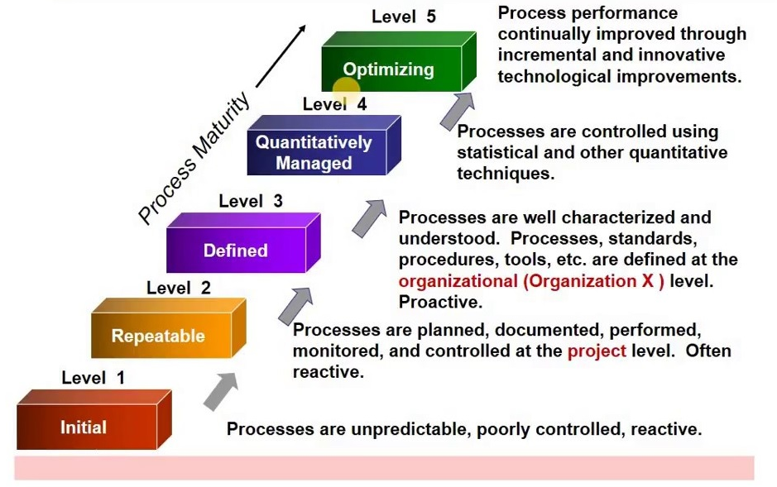

Slide 6
Level-1 = Initial
The process is usually unpredictable and ad-hoc
Capability is characterized on the basis of individuals not of the organization

Slide 7
Level-2 = Repeatable
Estimate project parameters like cost, schedule and functionality
Develop plan and process
Project Planning -
Includes defining required resources, goals, constraints, etc.
Presents a detailed systematic plan to be followed for the successful completion of good quality software.
Configuration Management -
Focuses on maintaining the performance of the software product
Requirements Management -
Includes the management of customer reviews and feedback which result in some changes in the requirement set.
It also consists of accommodation of those modified requirements.

Slide 8
Level-3 = Defined
Documentation of the standard guidelines and procedures takes place
Well-defined integrated set of project-specific software engineering and management processes
Peer Reviews –
Removes defects by using a number of review methods like walkthroughs, inspections, buddy checks, etc.
Intergroup Coordination -
Consists of planned interactions between different development teams to ensure efficient and proper fulfillment of customer needs
Organization Process Definition -
Focuses on the development and maintenance of the standard development processes

Slide 9
Organization Process Focus -
Includes activities and practices that should be followed to improve the process capabilities of an organization
Training Programs -
Focuses on the enhancement of knowledge and skills of the team members including the developers and ensuring an increase in work efficiency

Slide 10
Level-4 = Managed
Quantitative quality goals are set for the organization for software products as well as software processes
The measurements made help the organization to predict the product and process quality within some limits defined quantitatively
Software Quality Management - It includes the establishment of plans and strategies to develop quantitative analysis and understanding of the product’s quality
Quantitative Management - Focuses on controlling the project performance in a quantitative manner

Slide 11
Level-5 = Optimizing
Focuses on continuous process improvement in the organization using quantitative feedback
Use of new tools, techniques, and evaluation of software processes is done to prevent recurrence of known defects
Process Change Management - Focuses on the continuous improvement of the organization’s software processes to improve productivity, quality, and cycle time for the software product
Technology Change Management - Consists of the identification and use of new technologies to improve product quality and decrease product development time
Defect Prevention - Focuses on the identification of causes of defects and prevents them from recurring in future projects by improving project-defined processes.

Slide 12
Limitations of CMM Models
CMM determines what a process should address instead of how it should be implemented
Does not explain every possibility of software process improvement

Slide 13
Why use CMM?
It guides towards repeatable standard process and hence reduce the learning time on how to get things done
Practicing CMM not only helps the team to save time but also gives a clear view of what to do and what to expect
It acts as a commuter between the project and the team
CMM efforts are always towards the improvement of the process

